Slide 1
Consulting Proposal
By Team TechNerds

Slide 2




The TechNerds
Sahil Gazi
Rahul Roonwal
Avinash Mahanthi
Rajeev Nayan
Data Structure and Algorithms Pundit
Problem Solving Lover
App and Web Developer
Data Visualization and Machine Learning Enthusiast

Slide 3
Problem Statement & Impact
One of the major Climatic aspect of India is Rainfall. It has both pros and cons.
Pros are helpful for farmers to grow crops, essential to the survival of every living beings.
Cons are flooding, including risk to human life, damage to buildings and infrastructure, and loss of crops and livestocks.
If we predict the range of rainfall in advance, There are chance to decrease the risk of loss.

Slide 4
Proposed Solution
We have tried to predict the average rainfall by separating the data into Training and Testing. We applied various statistical and machine learning approaches in prediction and made analysis over various approaches. We used 70% of data to train and 30% data to test, whichever model had given the good accuracy we have used that model to predict the rainfall in a particular region.

Slide 5
Steps Involved
Start |  |  |  |  |  |  | End
Data Collection
Data exploration and preprocessing
Data Visualization
Data Modelling and Accuracy
Global go-live
Output

Slide 6
Technical Stack
Jupyter Notebook
Python
Flask
Machine Learning
HTML
CSS
Bootstrap

Slide 7
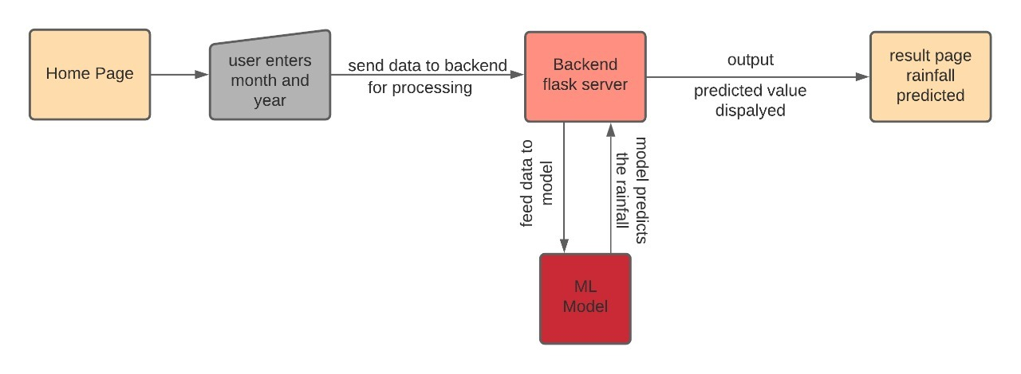
Workflow Chart

Slide 8
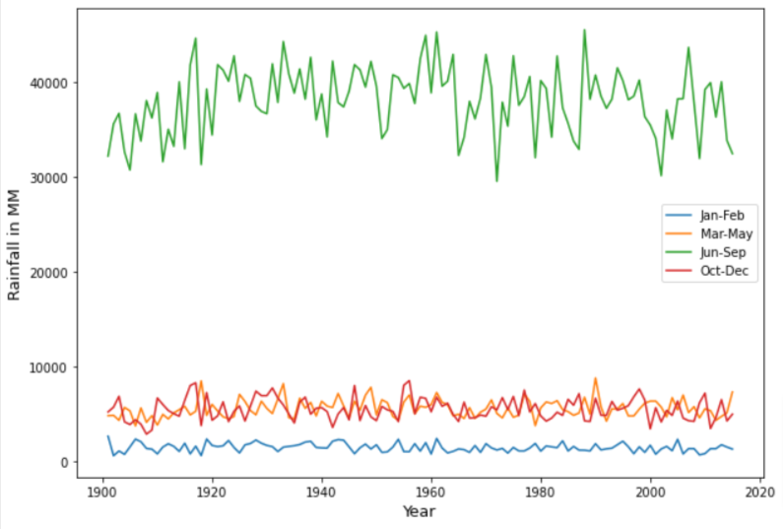
Trend Analysis
Findings
During June-sept India receives huge rainfall.
In Jan and Feb it experiences less rainfall.

Slide 9
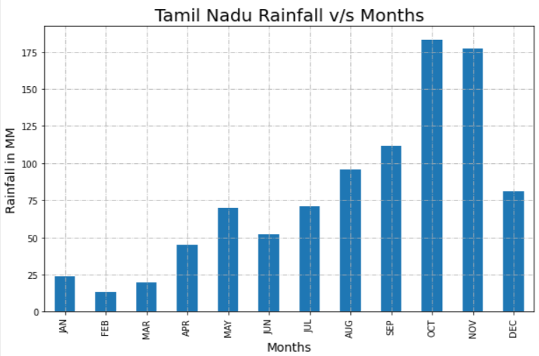
Trend Analysis of Tamil Nadu
Findings
From the graph we observe that
Tamil Nadu has good amount of rainfall in Oct and Nov

Slide 10
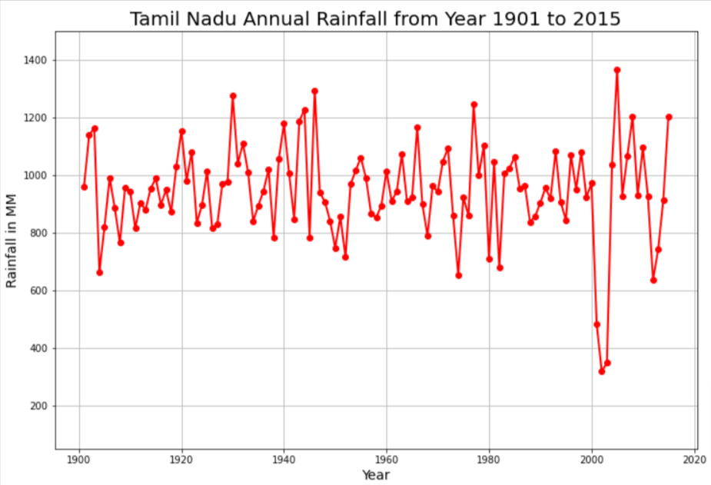
Trend Analysis of Tamil Nadu
Findings
The lowest rainfall in Tamil Nadu was noted in 2002-2003
The highest rainfall was noted in 2005

Slide 11
Business Model
> This model can be used by the government to predict Floods and Rainfall analysis in various vulnerable regions of the country beforehand so that safety measures can be taken.
> Effective real-time flood forecasting models could be useful for early warning and disaster prevention.
> Flood forecasting can also make use of forecasts of precipitation in an attempt to extend the lead-time available.
> Rainfall analysis can help in anticipation of crop yield and gross production value in the region.

Slide 12
Business Impact
> An alternate solution can be acquisition of factors like humidity, wind flow, geographical location etc into the dataset.
> Model can be deployed by government in flood prone areas for advance warning.
> Can be used for early decision making of disaster relief responses.
> Can be used for various industrial companies whose products are affected by rainfall patterns.
> Can be used in agriculture industry for proper planning beforehand.
> Can be used in predicting suitable climatic condition of areas for transportation of goods and services for companies.

Slide 13
Challenges Faced
> Collection of reliable data from different origins.
> Deciding on a particular machine learning model for achieving maximum accuracy without overfitting the data to it.
> Improving the accuracy of the model with limited data sources available.
> Integrating the model with an User Interface.

